Slide 1




Slide 2



Slide 3



Slide 4

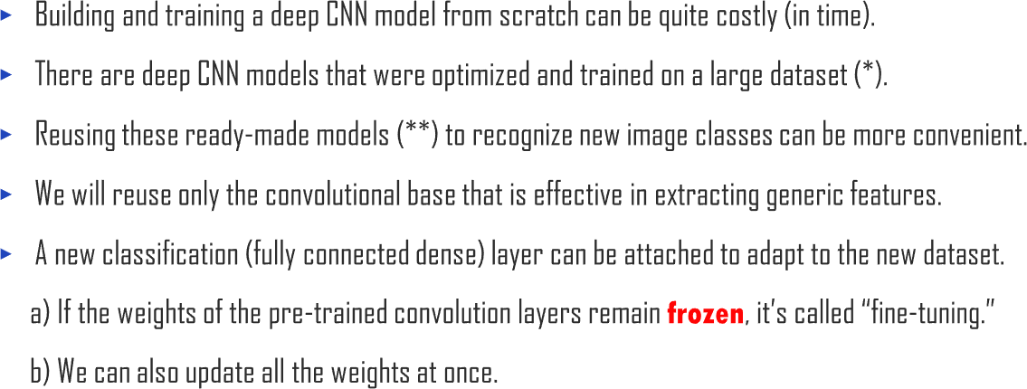
1. Using a Ready-Made CNN Model
UNIT 01

Slide 5





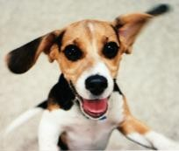




1. Using a Ready-Made CNN Model
UNIT 01

Slide 6




1. Using a Ready-Made CNN Model
UNIT 01

Slide 7




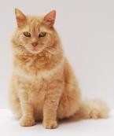

1. Using a Ready-Made CNN Model
UNIT 01

Slide 8


1. Using a Ready-Made CNN Model
UNIT 01

Slide 9
1. Using a Ready-Made CNN Model
UNIT 01

Slide 10
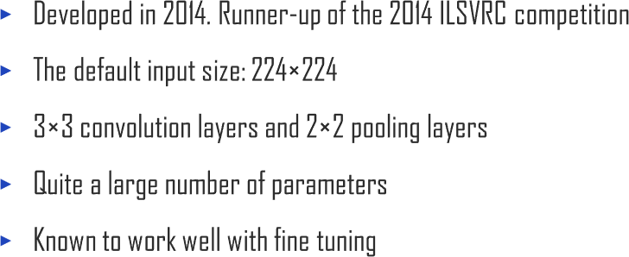



1. Using a Ready-Made CNN Model
UNIT 01

Slide 11
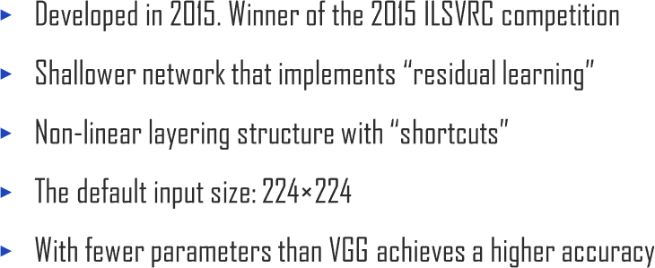
1. Using a Ready-Made CNN Model
UNIT 01

Slide 12
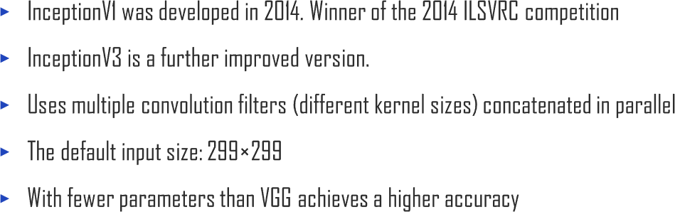


1. Using a Ready-Made CNN Model
UNIT 01

Slide 13
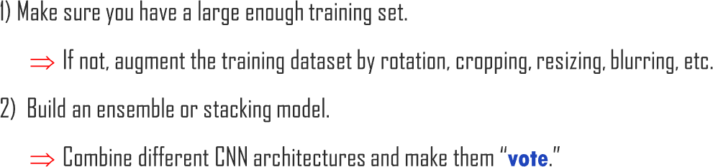
1. Using a Ready-Made CNN Model
UNIT 01

Slide 14




Slide 15
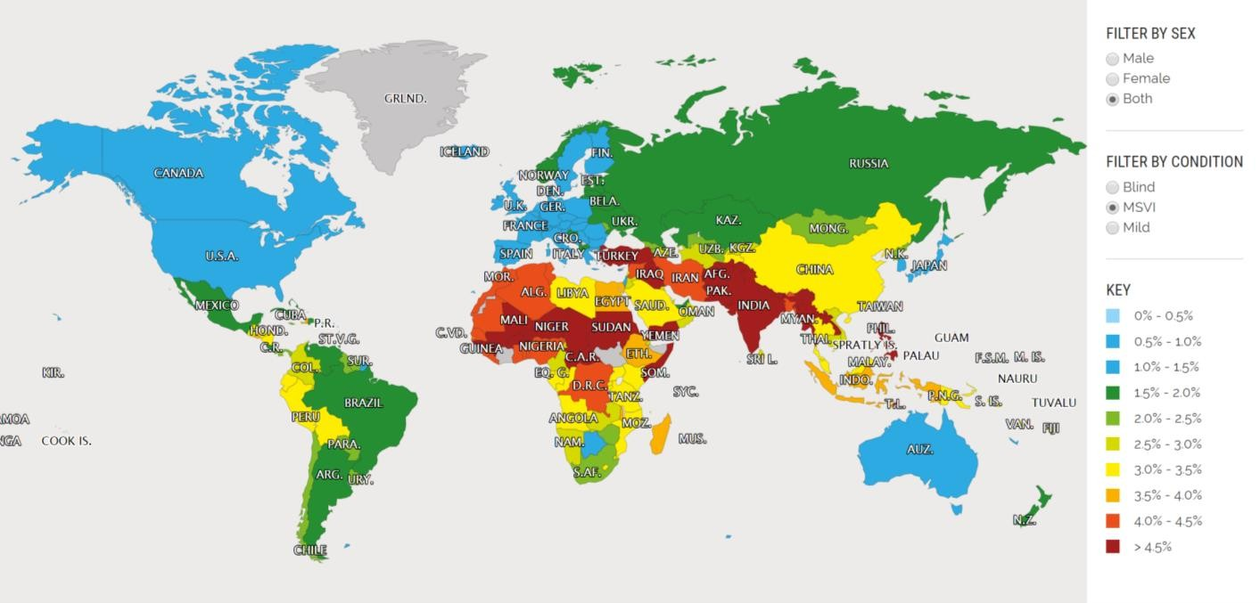

2.1. AI-based Clinical Decision Support System
UNIT 02

Slide 16

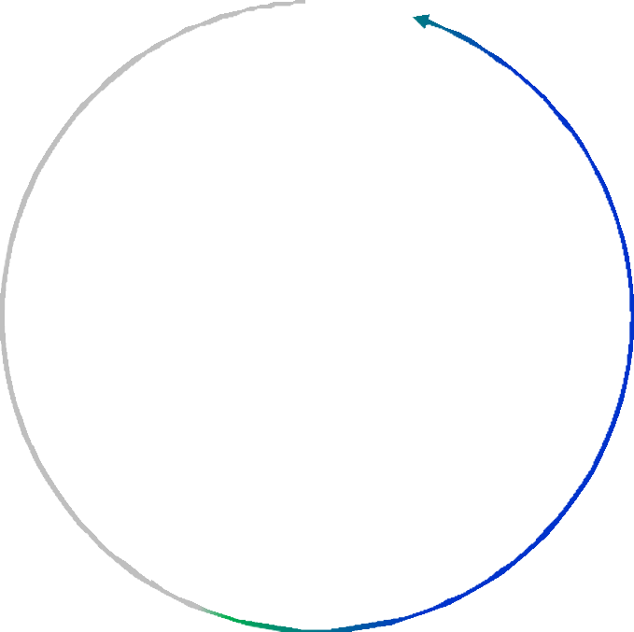






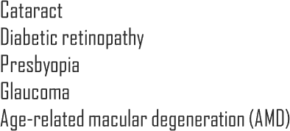








2.1. AI-based Clinical Decision Support System
UNIT 02

Slide 17
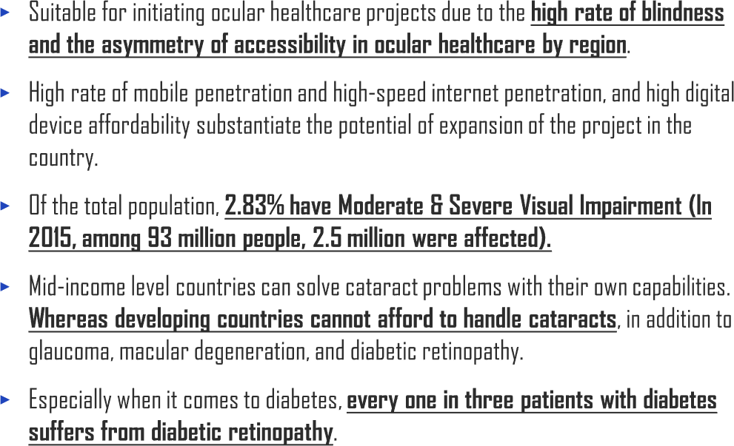
2.1. AI-based Clinical Decision Support System
UNIT 02
Quang Tri
The region has the lowest average income among 63 districts in the country.
Poverty rate is 21.7% in 2015 (national average: 12.5%).
Low agricultural productivity due to the defoliant sprayed during the Vietnam war.

Slide 18

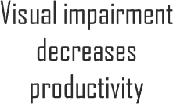
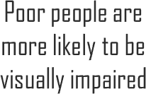

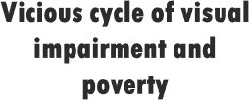
2.1. AI-based Clinical Decision Support System
UNIT 02

Slide 19

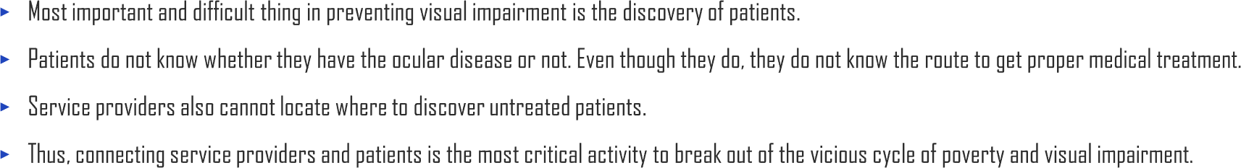
2.1. AI-based Clinical Decision Support System
UNIT 02
Medical service providers cannot find patients.
Disconnected
Patients do not know
how to reach out to service providers.

Slide 20

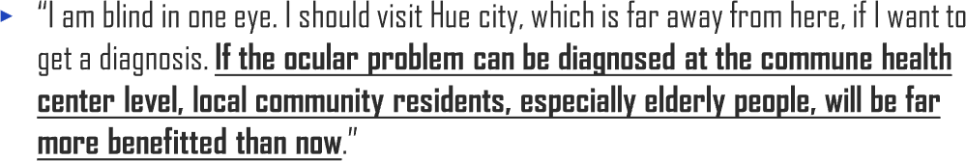

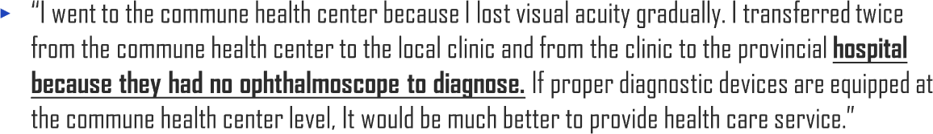
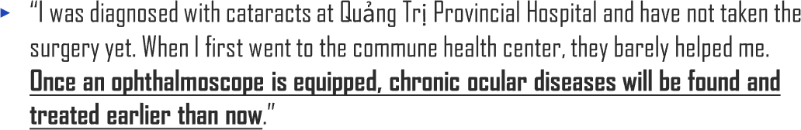

2.1. AI-based Clinical Decision Support System
UNIT 02
Ms. N (Age: 70,
not a patient)
Mrs. G (Age: 65, Anomalies of refraction)
Mr. N (Age: 66, not a patient)

Slide 21

2.1. AI-based Clinical Decision Support System
UNIT 02
Dr. D, Ophthalmologist
Quảng Trị Provincial Hospital
Dr. V, Head of Center
Commune Health Center

Slide 22

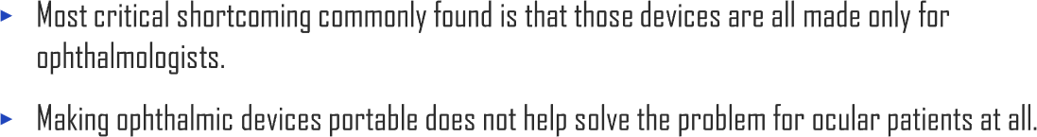

2.1. AI-based Clinical Decision Support System
UNIT 02
PEEK Vision (UK) | Photograph fundus using smartphones | Get a medical specialist’s interpretation of image transmission via message service
Welch Allyn (US) | Take a zoomed-in photograph with portable ophthalmic devices and smartphones | Hard to focus because of the miosis and eye movement by light
Goblink (US) | Measure visual acuity, anomalies of refraction, and pupillary distance with smartphones Commercialized using portable ophthalmic devices and smartphones Deliver information to optometrist and optician | Direct synchronization with smartphones is unsupported Cannot obtain information of disease other than anomalies of refraction
Horus (Taiwan) | Photograph fundus without using mydriatic Support high-quality image and video Real-time screen sharing via wi-fi | High retail price deters mass adoption Requires a high level of skills for non-specialist doctors
Vula Eye (Switzerland) | Connect patients living in mountainous areas with medical specialists Conduct a visual acuity test with a simple guidance Obtain accurate and detailed information via web chat with specialists | Restricted applicability to cataract and retinal diseases, which are major causes of blindness

Slide 23
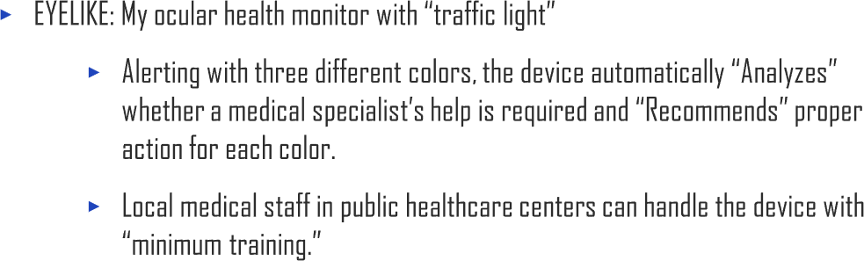



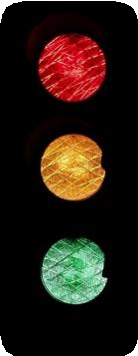
2.1. AI-based Clinical Decision Support System
UNIT 02

Slide 24
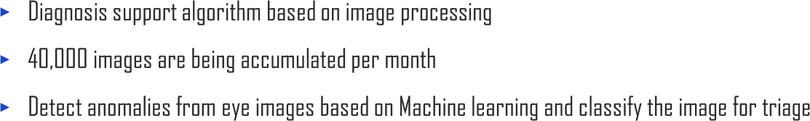
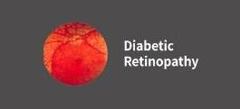
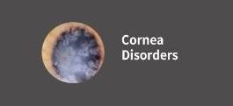
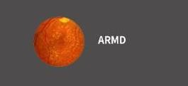
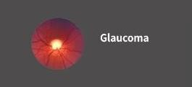
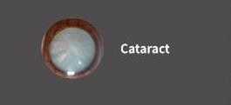
2.1. AI-based Clinical Decision Support System
UNIT 02

Slide 25
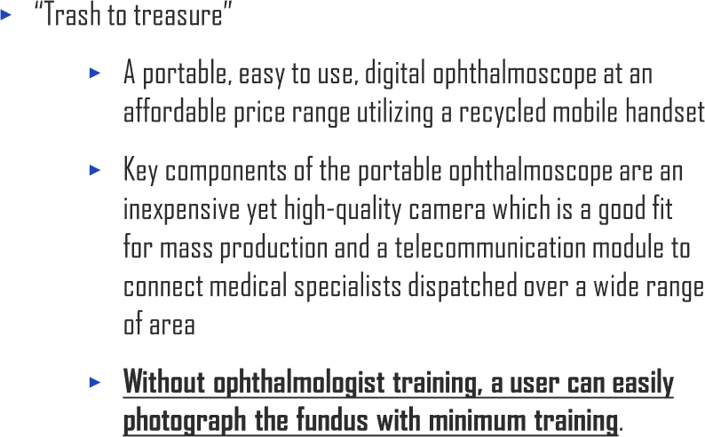

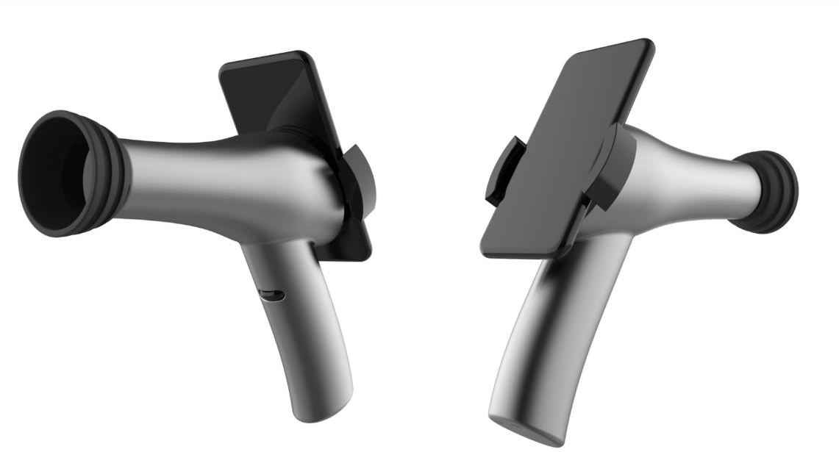
2.1. AI-based Clinical Decision Support System
UNIT 02

Slide 26
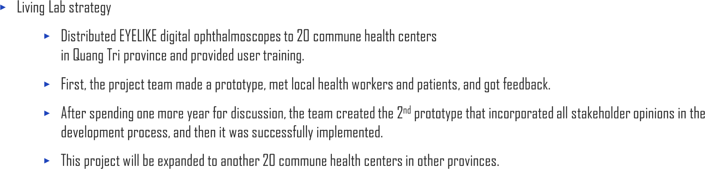
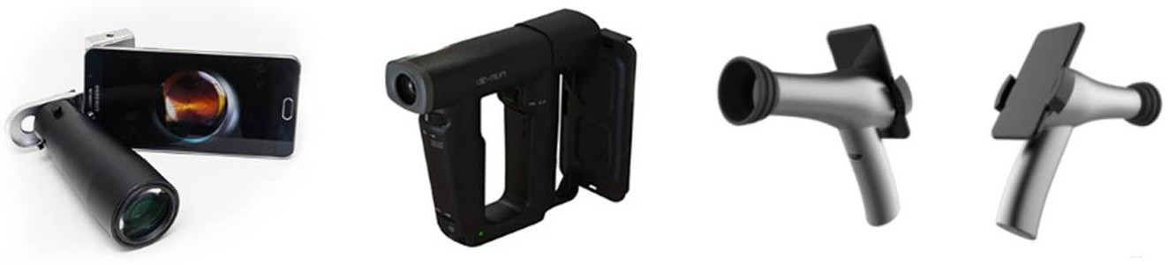
2.1. AI-based Clinical Decision Support System
UNIT 02
2016
2017
2018

Slide 27
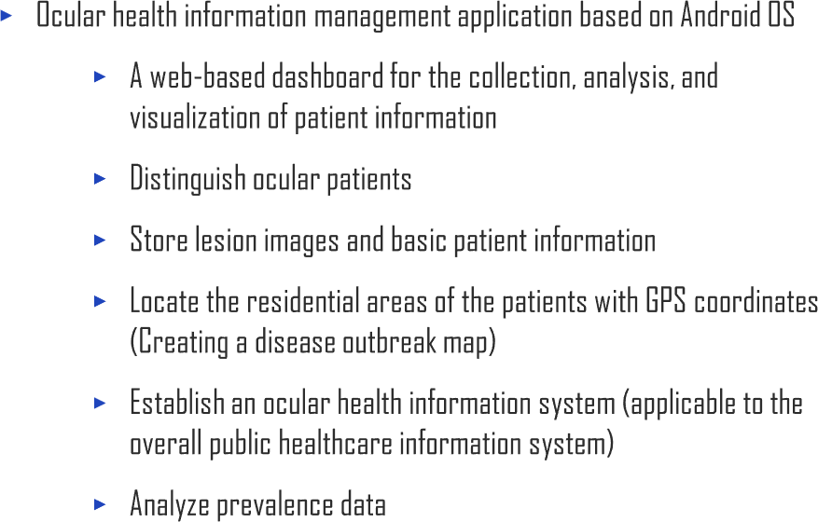
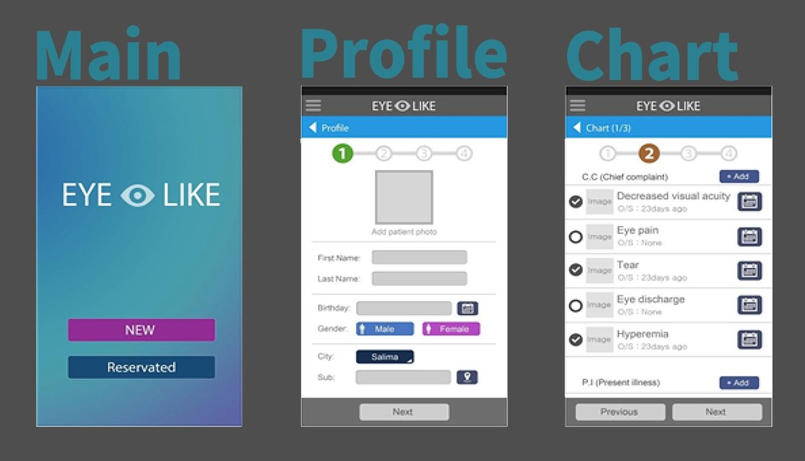
2.1. AI-based Clinical Decision Support System
UNIT 02

Slide 28
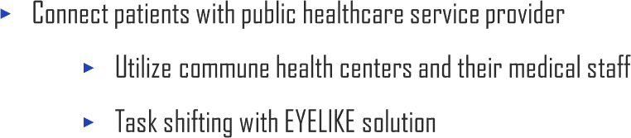
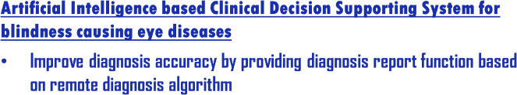
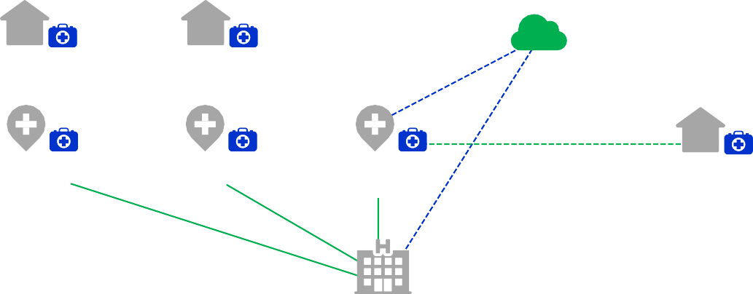


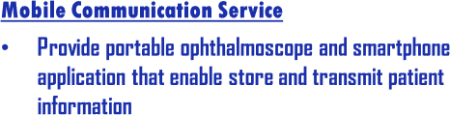



2.1. AI-based Clinical Decision Support System
UNIT 02

Slide 29

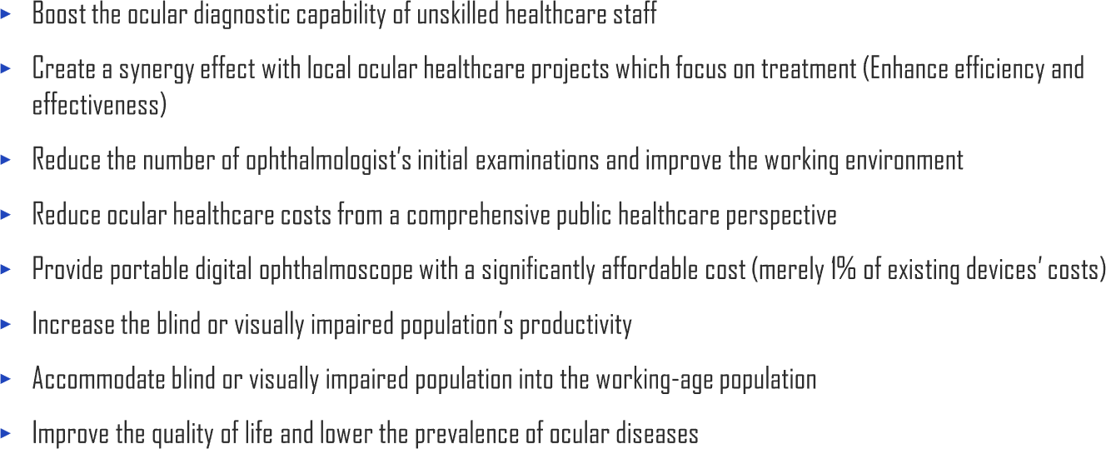
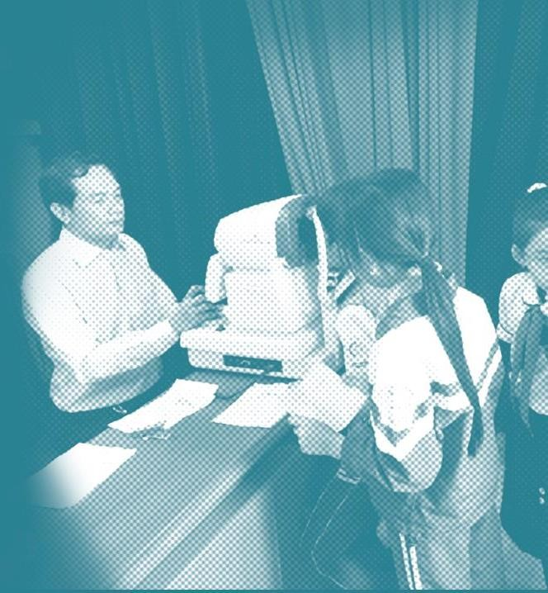
2.1. AI-based Clinical Decision Support System
UNIT 02

Slide 31




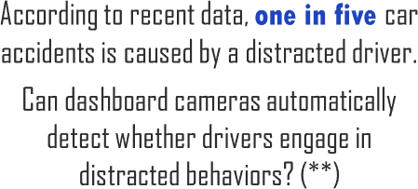
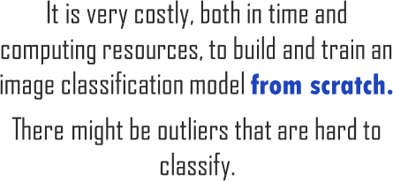
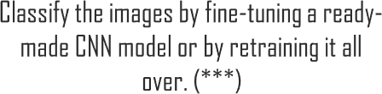

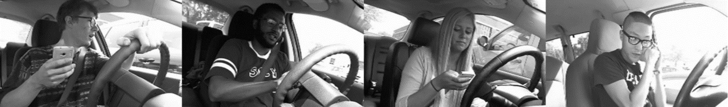

2.2. Other AI Application Cases
UNIT 02

Slide 32
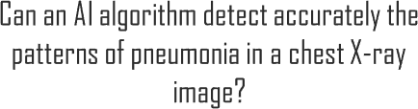

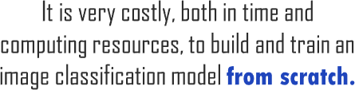
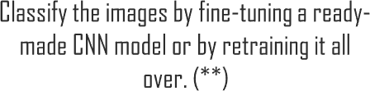
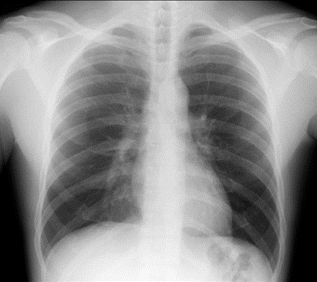

2.2. Other AI Application Cases
UNIT 02

Slide 33

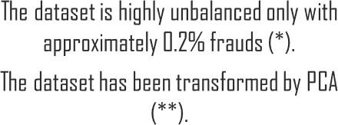
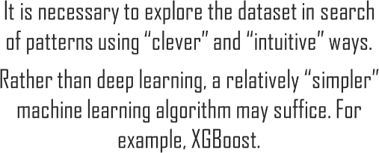


2.2. Other AI Application Cases
UNIT 02

Slide 34

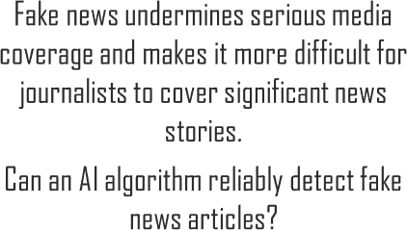



2.2. Other AI Application Cases
UNIT 02

Slide 35



Slide 36


